Slide 1





COMP-8547 ADVANCED COMPUTING CONCEPTS
WEB SEARCH ENGINE
FALL 2023
BY GROUP 6
Instructor: Dr. Luis Rueda
Group Members:
Siddh Patel (110128298)
Amit Kumar (110124005)
Vikrant Singh (110125671)
Prajwal Banakar (110127074)
Sadia Anzum (110126278)
Date: December 4, 2023

Slide 2
CONTENTS
Contribution
Introduction
Project Components
Implementation
Challenges and Considerations
Demonstration
Conclusion
Acknowledgement
References
Slide 1

Slide 3
Slide 2
CONTRIBUTION
Siddh Patel
Sadia Anzum
SID: 110128298
SID: 110126278
Edit distance &
Web Crawling
Web Crawling &
Inverted Index
Amit Kumar
Vikrant Singh
Prajwal Banakar
SID: 110124005
SID: 110125671
SID: 110127074
Web Crawling &
Regex
Inverted Index &
Edit Distance
Inverted Index &
Sorting

Slide 4



Introduction
A web search engine is a software system designed to search for information on the World Wide Web. It provides users with a list of related results based on their textual web search queries.
The information may be a mix of hyperlinks to web pages, images, infographics, articles and other types of files.
Definition
In the digital age, web search engines are essential for information retrieval as they allow users to quickly and efficiently access a large amount of information. They now play a crucial role in our everyday activities, influencing the way we obtain, use, and share information.
Importance
Slide 3

Slide 5

Project Components
Our project aims to develop a web search engine, encompassing the following key processes:
Web Crawling
Inverted Indexing
Search & Edit Distance
Sorting
Slide 4

Slide 6
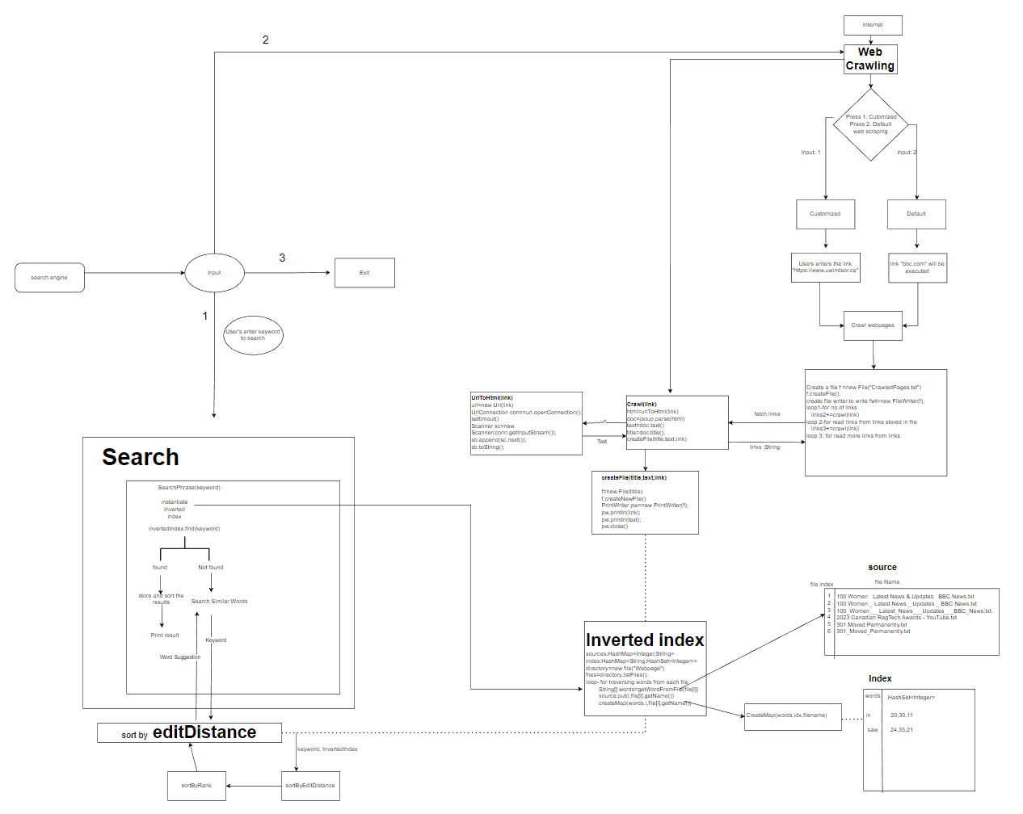
Flowchart of Web Search Engine
Slide 5

Slide 7
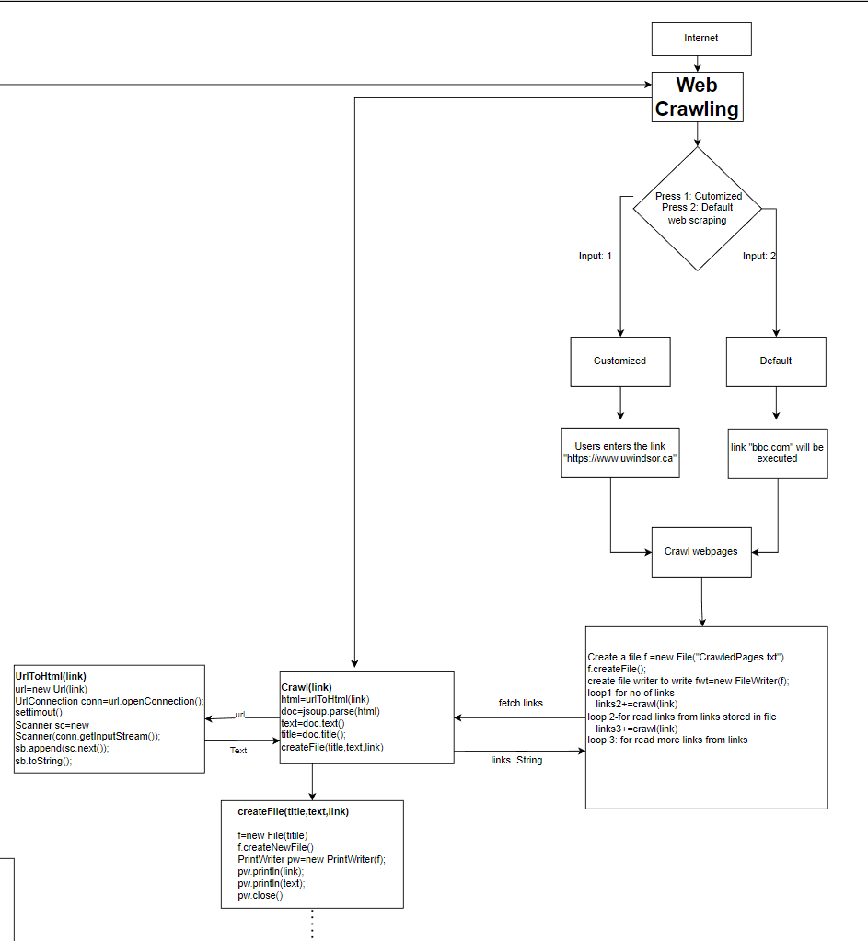
1
Web Crawling
Web crawling is the process of systematically browsing the internet to collect information from web pages. The purpose is to gather data for web indexing and analysis.
How does a crawler work?
Web crawlers start their crawling process through Jsoup library
Connection to webpage is establish through urlToHTML(String link) function with URLConnection conn = url.openConnection().
Crawlers add newly discovered URLs to the crawl queue .
With this flow, web crawlers can index every single page that is connected to others.
Architecture of a web crawler module
Slide 6

Slide 8
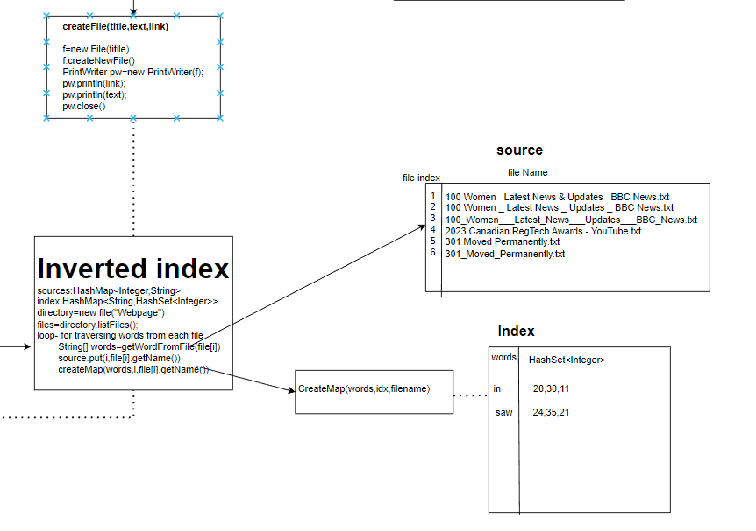
2
Inverted Indexing
Indexing means associating words and other definable tokens found on web pages to their domain names and HTML-based fields. The associations are made in database, made available for web search queries.
How does it work?
Purpose: Implements an Inverted Index for efficient information retrieval.
Components: sources: Maps file sources (IDs, filenames), index: HashMap for word occurrences (word, file IDs).
Construction: Tokenization and Stemming extracts clean words from files.
Dictionary Creation: Builds a dictionary with terms as keys, Utilizes sources for file locations.
Slide 7

Slide 9
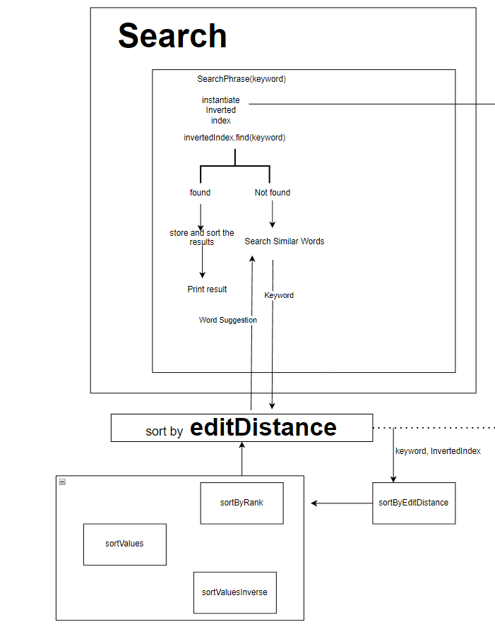
3
Search And Edit Distance
How does it work?
Executes a phrase search in the Inverted Index..
Searches for the exact phrase in the Inverted Index
If not found, initiates a search for similar words using SearchSimilarWords class..
Sorts and ranks the results using SortResults class.
Prints the top results, considering the specified numberOfResults
Slide 8

Slide 10
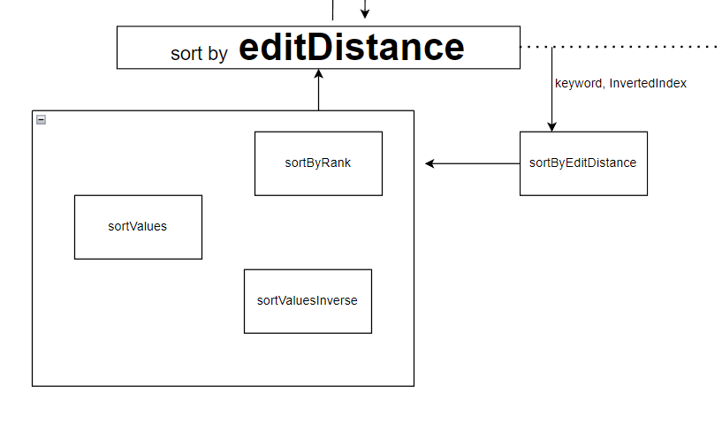
4
Sorting
How does it work?
Sorts search results based on rank and occurrence count.
sortByRank(List<String> as, String phrase)
Purpose: Sorts search output in descending rank.
sortValues: Sorts values of the given HashMap in ascending order
Purpose:Sorted HashMap in ascending order.
sortValuesInverse
Purpose: Sorts values of the given HashMap in descending order
Slide 9

Slide 11
CHALLENGES AND CONSIDERATIONS
SCALABILITY
ETHICAL AND LEGAL CONSIDERATIONS
Handling Large Datasets: Efficient Data Structures and Algorithms are essential to manage and process vast amounts of information.
Distributing Workload: To handle scalability challenges, distributing the workload across multiple servers or nodes can be implemented. This ensures that the web crawling, indexing, and search processes are distributed, preventing bottlenecks.
Respecting Website Policies: Adhering to robots.txt files, terms of service, and website policies is crucial for ethical web crawling. Failure to respect these guidelines may lead to legal consequences and damage the reputation of the search engine.
User Privacy and Data Security: Ensuring data security and safeguarding user privacy are critical. An trustworthy search engine is enhanced by the use of secure data storage procedures and, when needed, the anonymization of user data.
Slide 10

Slide 12
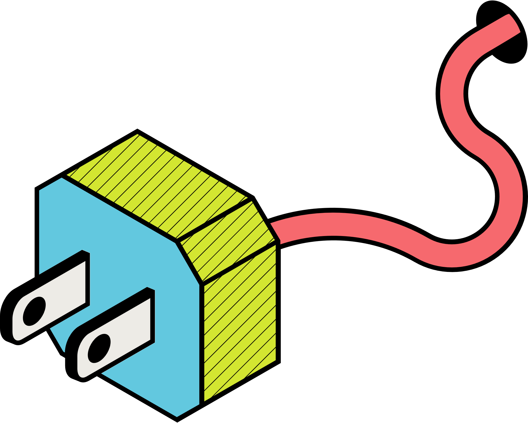
Demonstration
Slide 11

Slide 13
Conclusion
The implemented search engine, combining inverted index, web crawling, and edit distance with sorting capabilities, delivers a robust solution for information retrieval. The synergistic integration of these components enhances the search experience and provides users with meaningful and relevant results.
Key Components:
Inverted Index:
Enables efficient keyword-based searches.
Accelerates retrieval by mapping words to document locations.
2. Web Crawling:
Gathers a diverse set of web pages for indexing.
Ensures a comprehensive search space for users.
3. Edit Distance and Sorting:
Enhances search flexibility by considering similar words.
Prioritizes results based on relevance and occurrence frequency.
Slide 12

Slide 14

Slide 13
References
R. Cole, “Tight bounds on the complexity of the Boyer-Moore pattern matching algorithm,”
SIAM Journal on Computing, vol. 23, no. 5, pp. 1075–1091, 1994.
D. Comer, “The ubiquitous B-tree,” ACM Comput. Surv., vol. 11, pp. 121–137, 1979.
A. V. Aho, J. E. Hopcroft, and J. D. Ullman, Data Structures and Algorithms. Reading, MA:Addison-Wesley, 1983.
Wikimedia Foundation. (2023, November 14). Search engine. Wikipedia. https://en.wikipedia.org/wiki/Search_engine
Employeeonboardingprocess. (2021, April 15). Web crawling. Web browser. https://web.archive.org/web/20211206205907/https://webbrowsersintroduction.com/
https://research.aimultiple.com/web-crawler/
https://en.wikipedia.org/wiki/Web_crawler
https://www.elastic.co/guide/en/elasticsearch/guide/current/inverted-index.html
https://www.geeksforgeeks.org/inverted-index/
https://www.techtarget.com/whatis/definition/search-engine

Slide 15
Acknowledgement
We extend our heartfelt gratitude to our course instructor, Dr. Luis Rueda and our GA, Darpan Khanna, for their invaluable guidance and unwavering support throughout this project. Your continuous encouragement and insights that greatly enriched our learning experience.
Special thanks go out to our fellow classmates for their collaboration and shared enthusiasm.
Slide 14

Slide 16
Thank you.
Slide 15

